Slide 1
Using machine learning to detect crop disease
David Chen

Slide 2
Why pick this?
Inspired to take this topic from watching campaigns ran for starving children.
I believe that this will be important if we as humans are to grow.
A massive problem with the potential food security resulting from the diseases
A stark difference between food availability in different countries.
Prices of food going up when they don’t have to.
Can at least slow down this problem.

Slide 3
What is crop disease and why is it important?
Defined as an abnormal growth or dysfunction within a plant.
Can take the form of fungal, bacterial, viral and nematodes(notes:worm like parasitic such as roundworm or threadworm)
Responsible for over 40% of crop losses per year.(notes:compare the land of a crop at 100% efficiency and at 60% efficiency)
Estimated by the United Nations Food and Agriculture Organisation, almost 1 billion people are starving, or one in ten.
Demand for food is rocketing, rising between 59% to 98% by 2050.(https://onlinelibrary.wiley.com/doi/abs/10.1111/agec.12089)(notes:without discounting land needed to build new homes-losing land for food). Supply is reaching a standstill

Slide 4
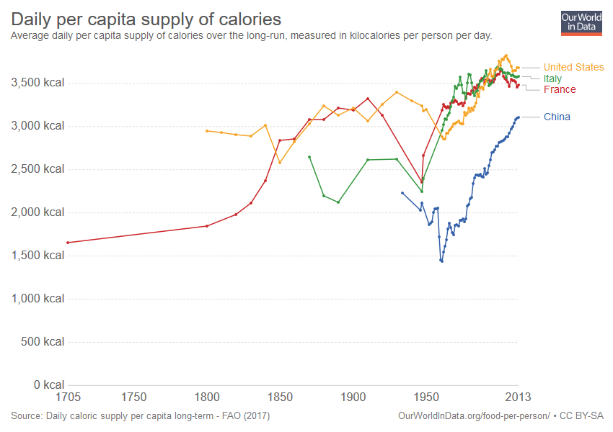
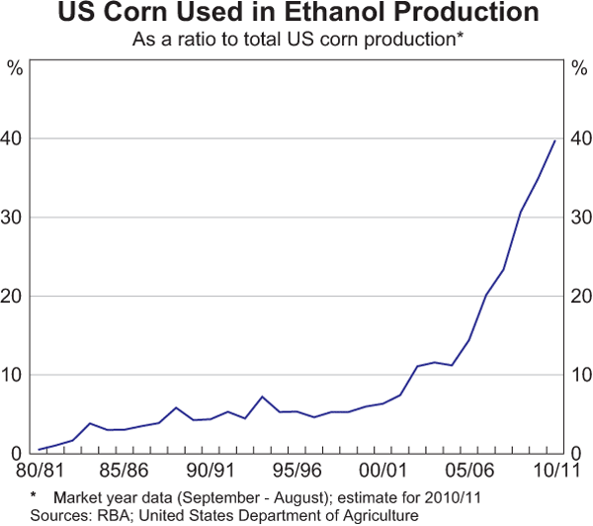

Slide 5
Current methods
Manual is the main
Can do it biologically
Can do it via eye( in 3rd world countries)
Done by teaching people how to in school centres
Done by flying professionals in

Slide 6
Advantages, disadvantages
Advantages:
Accurate
Disadvantages:
Time consuming
Expensive(flying professionals, teaching, etc)
Often requires permit from governments

Slide 7
Using machine learning
Takes picture
Translates the pixels of the picture into numbers the computer reads
Uses classification(talk about that here) to generate and assign labels to certain values.
(in epq talk about how single pictures not farmlands)
Computer learns all the time
Can upgrade at the pace of technology innovations

Slide 8
Advantages and disadvantages
Advantages
Fast
Cheap to maintain
Easy to use
Can take bulk pictures and classify multiple plants at once
Disadvantages:
Only above 90% accurate when in single pictures
Requires decent computational power

Slide 9
Evaluation

Slide 10
Conclusion

